Slide 1
Java/J2EE Session- 13
Web Servers
and
Application Server

Slide 2
Contents
What is a Web Server
What is a Application Server
How to deploy the application.
Installing Tomcat
Installing Tomcat plugin with NetBeans.
Configuring Tomcat.
Starting and Stopping of a tomcat server.

Slide 3
What is a Web Server
A Web Server handles HTTP protocol. When server received HTTPRequest and it will respond with the HTTPResponse.
To process a request a Web Server may respond with a static HTML page or image .
It can also forward the request to some other programs like a JSP.
Understand the web server delegation model is fairly simple. When a request comes in the web server simply passes the request to the program that best handles it.
The web server doesn’t provide any functionality beyond simply providing an environment in which a server side program can execute.
It the responsibility of the server side program to define the functionality.

Slide 4
What is a Web Server
Limitations of a web server
  It will not support any transactions.
  It will not support any connection pooling while connecting to the database
  Web server lacks some of the features like
    Load Balancing
    Caching
    Clustering
    Scalability
  It does not contain any J2EE Container where we can deploy the EJB’s.

Slide 5
What is a Application Server
The application server exposes business logic to client applications through various protocols and it may also include the HTTP Protocol.
An application server provides access to the business logic for use of the client application programs.
The information travelling back and forth between the application server and a client is not restricted to and markup language or image. Instead , the information is programming logic.

Slide 6
What is a Application Server
Advantages of the Application Server
  Support’s any transactions.
  Support’s any connection pooling while connecting to the database
  Application server has some of the features like
    Load Balancing
    Caching
    Clustering
    Scalability
    Messaging
  It does contain a J2EE Container where we can deploy the EJB’s.

Slide 7
How to deploy the application.
How to deploy the application. (The Problem Statement).
What does the application contain
  Single application can have multiple java class files which are scattered over multiple packages.
  Will have more than one JSP file
  A deployment descriptor.
  JavaScript files if any.
  Images which we display in the user interface.
  We can have a properties file to store the key attributes.
As the application can contain so much of information then how can we send this information to the Server.
  Assume a simple chat application like Google Talk.
  If we want to send a single file then we can do it with no issues.
  But if we want to send more than one file to a single person we have 2 possibilities
    Sending 5 files 5 times which is not a good approach because if we have 1000 files and its not possible to send it 1000 times.
    Compress all the file in to an Archive using WinZip or WinRar

Slide 8
How to deploy the application.
The best approach would be to use the Archive because we can send multiple file in a single go to the user.
In the similar fashion java is also having 4 different kinds of archive like
  JAR (Java Archive)
  WAR (Web Archive)
  EAR (Enterprise Archive)
  RAR (Remote Archive)
We can use any of the 4 archives that can be used to deploy the application.
An Archive in java is nothing but grouping of all the files in an application in to a single file.

Slide 9
How to deploy the application.
JAR (Java Archive):
  This is the most simple archive that is available in java.
  We generally use this to package the code which can be reused by a different application.
  We can’t deploy this type of archive directly in the server. It must be either associated by an WAR or EAR.
  We can also compress the set of EJBs in to a JAR file.
  A JAR file is not a web application it is a plain old java application which can be used in various applications.

Slide 10
How to deploy the application.
WAR (Web Archive):
  We use web archive to deploy Servlets and JSP files.
  The contain various kinds of sources and images like .java, .jsp, .xml, .css, .gif, .html, .png, .class etc.
  All we need to do is we need to deploy this .war in web server or application server and server takes care to identify the files that it requires.
  Note: Both JAR and WAR are independent terms. A WAR can have one or More than one JAR file within it.

Slide 11
How to deploy the application.
EAR (Enterprise Archive):
  It’s the combination of both JAR and WAR
  We group all the JAR’s and WAR’s to create a new archive called as EAR.
  We can deploy this EAR file only in Application Servers like WebSphere, Weblogic, JBoss etc…
  It can contain an EAR file which in turn contain .java, .class, .jsp file.
  It can also contain JAR files which in turn contain the .java files and also can contain EJB files.

Slide 12
Installing Tomcat
First step is to download the Tomcat server from the link below
  http://www.soft32.com/download_198250.html
The download will be in the format of a ZIP file. Please extract the file to C drive.
Next step is to download the JDK from the link below
  http://java.sun.com/javase/downloads/index_jdk5.jsp
  JDK 5.0 with Java EE (Click on this to download JDK)
  JDK 5.0 Update 22 with NetBeans IDE 6.7.1 (Click on this to download NetBeans)
Install both JDK 5.0 and and Net Beans in your machine.

Slide 13
Installing Tomcat
To start the server we need to have below configurations in the System Environment Variables.
  CATALINA_HOME = <tomcat root directory>.
  JAVA_HOME = <bin folder path in jdk home directory>.
For Example below are the directories where tomcat and JDK installed on my machine
  Tomat :
    C:\Documents and Settings\Administrator\My ocuments\Downloads\apache-tomcat-6.0.16
  JDK :
    C:\Program Files\Java\jdk1.5.0_22
So my environment variables would be
  CATALINA_HOME = C:\Documents and Settings\Administrator\My ocuments\Downloads\apache-tomcat-6.0.16
  JAVA_HOME = C:\Program Files\Java\jdk1.5.0_22

Slide 14
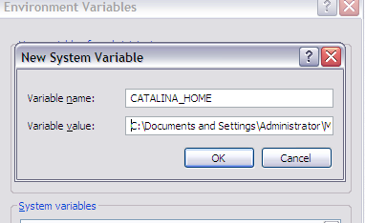
Installing Tomcat
How to add the environment variables.
  Right click on My Computers and Click on Properties.
  In the System Properties Dialog box click on Advanced tab
  In Advanced tab click on Environment Variables.
  On click of that we will see a new Dialog opening up.
  In the System Variables section click on New.
  Set the Variable Name and Value and click on OK
    Variable Name = CATALINA_HOME
    Variable Value = C:\Documents and Settings\Administrator\My ocuments\Downloads\apache-tomcat-6.0.16

Slide 15
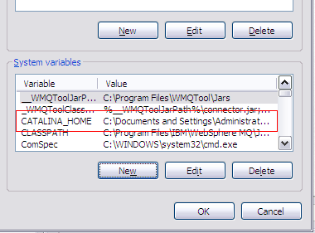
Installing Tomcat
Now you can find the variable added in the list like this.
Again click on New Button and give the below information
  Variable name = JAVA_HOME
  Variable value = C:\Program Files\Java\jdk1.5.0_22
We are now done with the installation of the server
Next step would be starting the server and check whether its running or not.

Slide 16
Installing Tomcat
Open the command prompt by giving the cmd command in our Run dialog.
Navigate to the folder where we have installed tomcat.
In the root director of tomcat give the below command
  cd bin
  startup
    This command will start the server.
  shutdown
    This command will stop the server.
Please find the screen shots in the following slides.

Slide 17
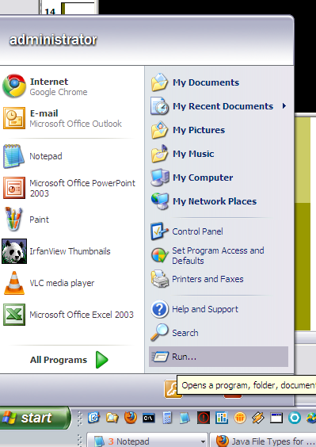
Installing Tomcat (Click on Run…)

Slide 18
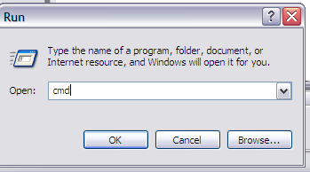
Installing Tomcat (Type in cmd and say ok)

Slide 19
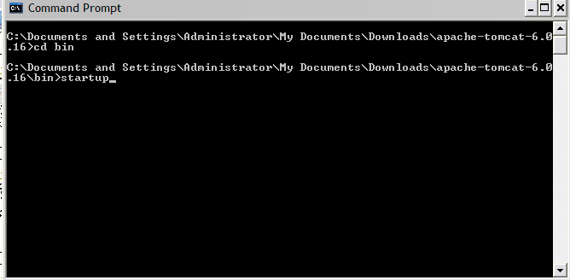
Installing Tomcat (Give the commands and hit enter)

Slide 20
Installing Tomcat (Creating User)
Open tomcat-users.xml file from the below path
  <tomcat installation directory>/apache-tomcat-6.0.16\conf
Write the below entries in the xml file
  <?xml version='1.0' encoding='utf-8'?>
  <tomcat-users>
  <role rolename="manager"/>
  <role rolename="admin"/>
  <user username="kumar" password="kumar" roles="manager,admin"/>
  <user username="kiran" password="kiran" roles="manager,admin"/>
  </tomcat-users>
We are creating 2 users with names Kumar and Kiran.
The user name and password can be anyone of your choice.

Slide 21
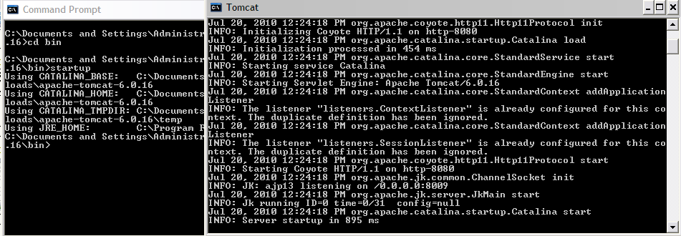
Installing Tomcat
New command window opens and shows the status of the server

Slide 22
Installing Tomcat (Checking)
Give in the below URL in your web browser and if tomcat home page opens up then it means the Installation and configuring of Tomcat is successful.
  http://localhost:8080/
We will see the page which is in next slide if the installation is successful.

Slide 23
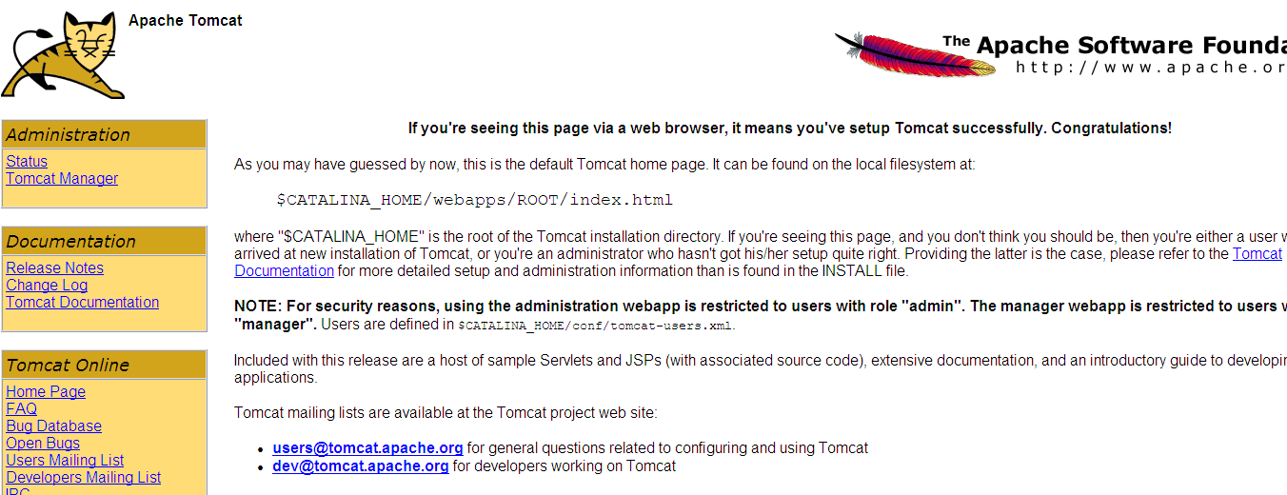
Installing Tomcat (Checking)

Slide 24
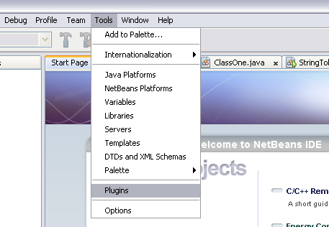
Installing Tomcat Plugin for NetBeans (Step 1)

Slide 25
Installing Tomcat Plugin for NetBeans (Step 2)
After clicking the plugins menu item in Step 1. It will open up a dialog box as show in the next slide.
In the dialog box just click on the Available Plugins tab
Then Check the checkbox for Java Web Applications
Then click on Install. On clicking this button it will ask for additional plugins needs to be installed as they are dependent say next.
Check the Accept terms and conditions and click install
Click Finish after the installation is complete

Slide 26
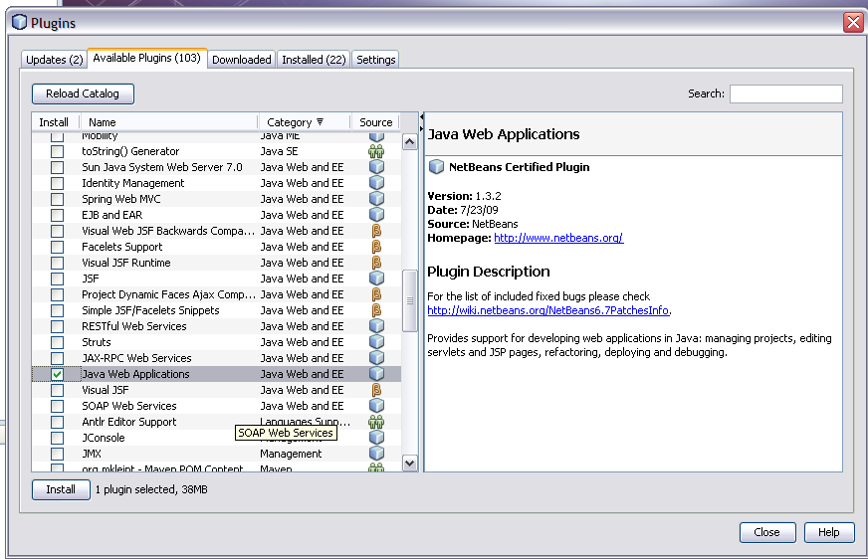
Installing Tomcat Plugin for NetBeans (Step 2)

Slide 27
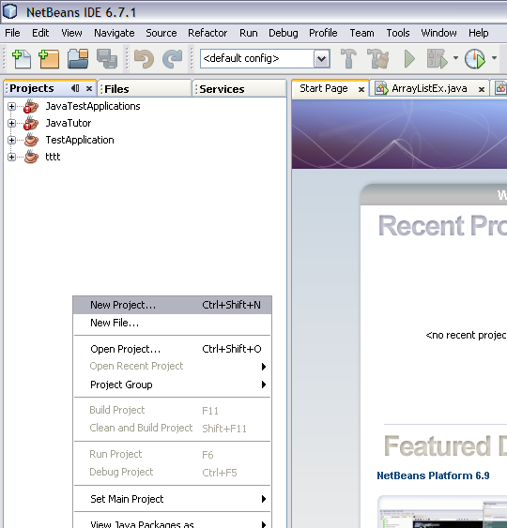
Installing Tomcat Plugin for NetBeans (Step 3)

Slide 28
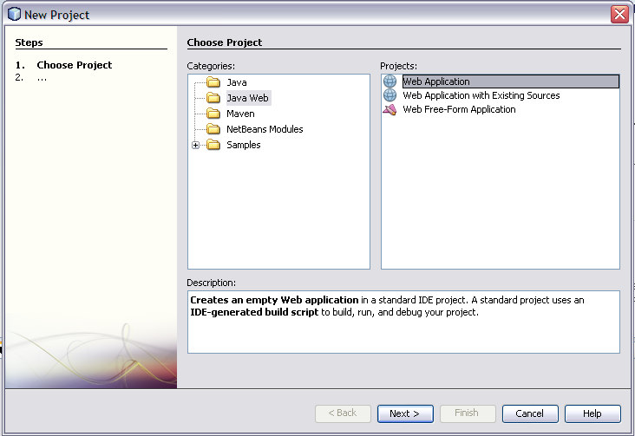
Installing Tomcat Plugin for NetBeans (Step 4)

Slide 29
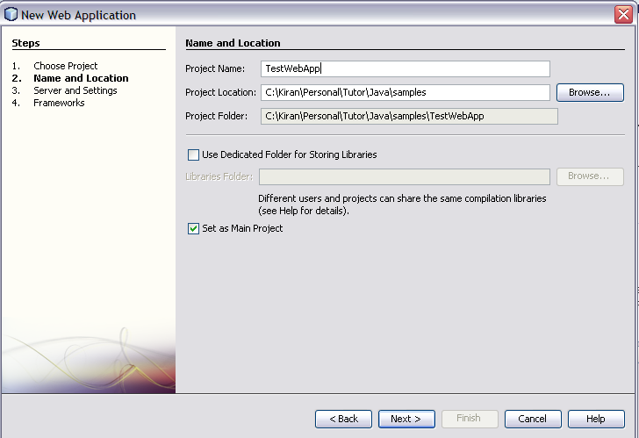
Installing Tomcat Plugin for NetBeans (Step 4)
Project Name and Location can be anyony you wish and say Next

Slide 30
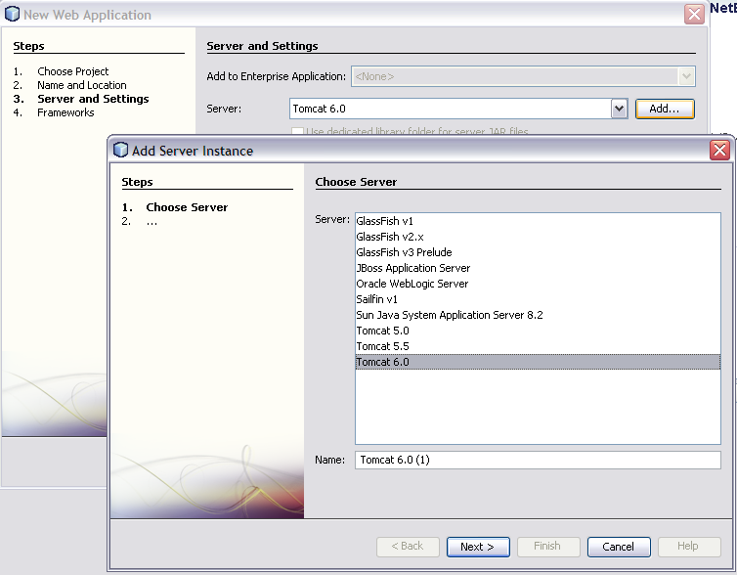
Installing Tomcat Plugin for NetBeans (Step 5)
In Server and Setting click on Add Button and in the dialog select Tomcat 6.0

Slide 31
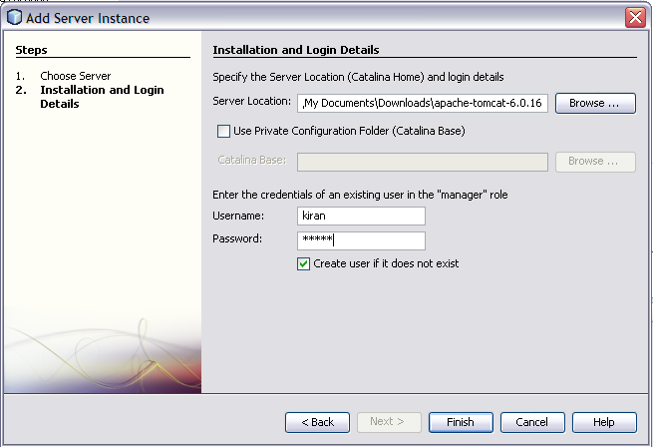
Installing Tomcat Plugin for NetBeans (Step 6)
Select the tomcat root folder on where it is present as shown below and give the Tomcat User Name and Password as you have given in tomcat-users.xml file and Say Next

Slide 32
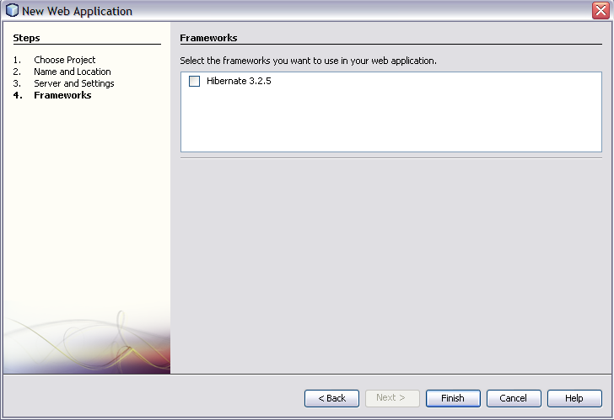
Installing Tomcat Plugin for NetBeans (Step 7)
Click on Finish

Slide 33
Installing Tomcat
Now we can find a new project called TestWebApp in the NetBeans Project view on Left Side.
Open the below URL in the webbrowser.
  http://localhost:8080/
Under the left Navigation click on Tomcat Manager
  It will ask for User Name and Password.
  Key in the same user name and password that you have configured in tomcat-users.xml file
  Then you will see the screen in the next slide.
  We can find our TestWebApp in the list of applications.

Slide 34
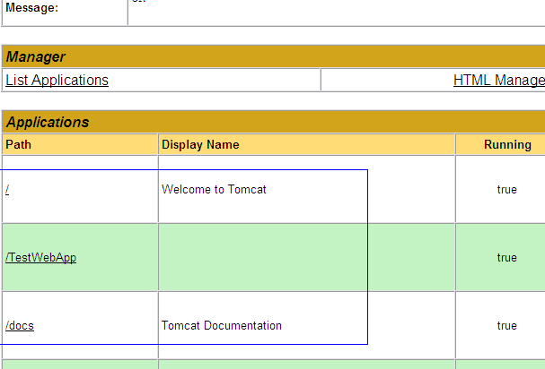
Installing Tomcat

Slide 35

Questions??

